Slide 1
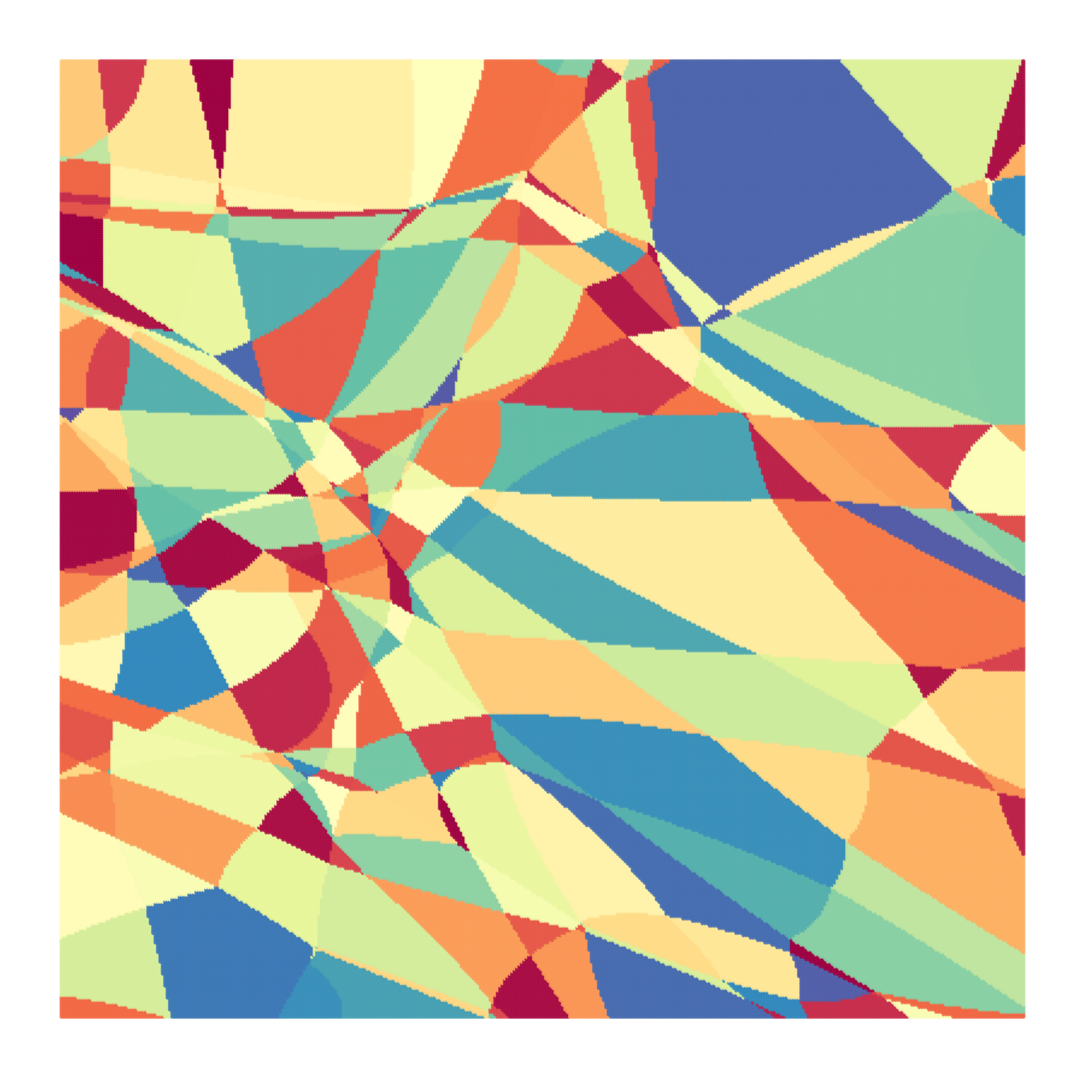
5 – Deep Neural Networks

Slide 2



Motivation
There is no way around deep artificial neural networks. They are one of the greatest achievements of our time!
Neural networks beating up DotA 2 world champions (2019, OG vs OpenAI 5)
Neural network-related Nobel prizes
BUT: In practice (and with sparse data), simpler models might often be the better choice! E.g., trees, random forests, linear regression, hand-crafted features / models, etc. So please do not treat neural networks like a magic silver bullet!

Slide 3
Content
Neural network definition
Approximating Lipschitz-continuous functions
Universal function approximation
Affine / linear pieces
Bounding the interpolation error
Depth separation
Error backpropagation and automatic differentiation

Slide 4
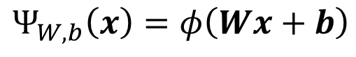
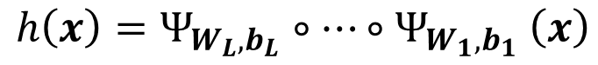
What is a neural network?
We will now look at a very famous hypothesis set: artificial neural networks (ANN)
We define a single layer of a neural network as:
non-linearity
linear regression!
$$Ψ_{W,b}\left(x\right)=φ\left(Wx+b\right)$$
where $W∈ℝ^{n_{2}×n_{1}}, x∈$ $ℝ^{n_{1}}$, ${b∈ℝ}^{n_{1}}$, and $φ$ is a non-linear function (activation function).
We then define the hypothesis set of $L$-layer neural networks to consist of functions:
$$h\left(x\right)=Ψ_{W_{L},b_{L}}∘…{∘Ψ}_{W_{1},b_{1}}\left(x\right)$$
Note: $W_{i}$ are commonly called the weights, and $b_{i}$ the biases.

Slide 5
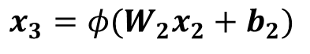
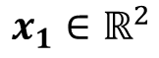
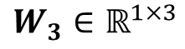
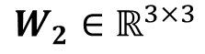
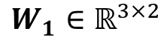
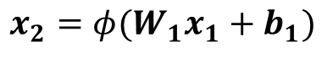
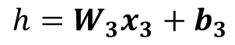
Sketch of an artificial neural network
$$x_{1}∈ℝ^{2}$$
$${x_{2}=φ(W}_{1}x_{1}+b_{1})$$
$${x_{3}=φ(W}_{2}x_{2}+b_{2})$$
$$h=W_{3}x_{3}+b_{3}$$
Input
Output
$$W_{1}∈ℝ^{3×2}$$
$$W_{2}∈ℝ^{3×3}$$
$$W_{3}∈ℝ^{1×3}$$

Slide 6
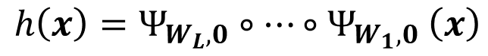
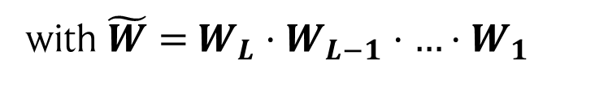
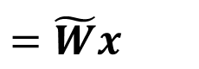
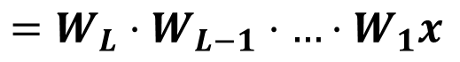
Question!
?
Why the non-linearity in each layer?
Assume we replace $φ$ by the identity, i.e., $φ\left(x\right)=x$. W.l.o.g., we set all biases $b_{i}=$ 0. Then we have:
$$h\left(x\right)=Ψ_{W_{L},0}∘…{∘Ψ}_{W_{1},0}\left(x\right)$$
$$=W_{L}⋅W_{L−1}⋅…⋅W_{1}x$$
$$=\tilde{W}x$$
with $\tilde{W}=$ $W_{L}⋅W_{L−1}⋅…⋅W_{1}$
That’s just linear regression!

Slide 7
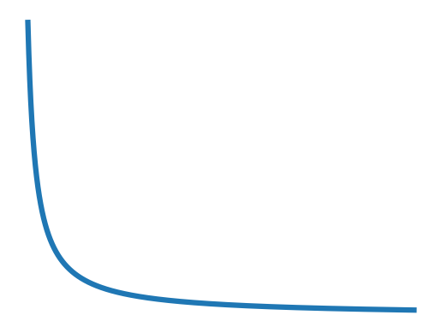
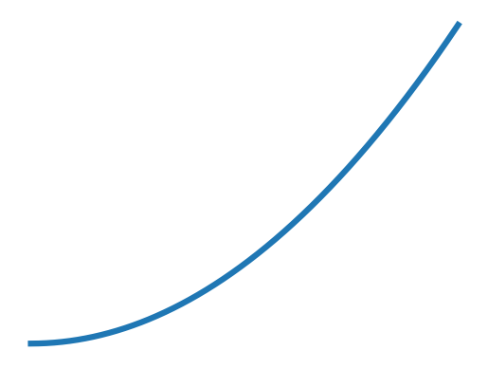
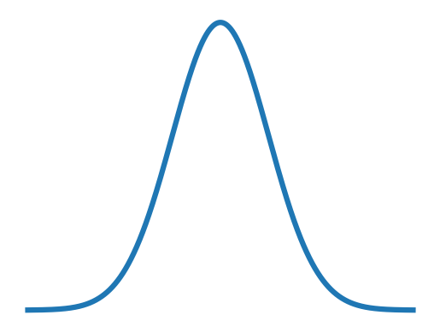
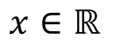
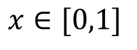
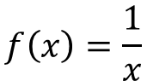
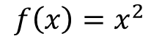
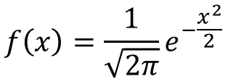
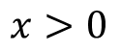
Warm-up: approximation properties of neural networks
So, what can we represent with neural networks?
Let’s start with a specific case: fitting Lipschitz continuous functions.
A function $g: ℝ→$ $ℝ$ is $L$-Lipschitz if for all $x,y∈ℝ$, we have
$$\left|f\left(x\right)−f\left(y\right)\right|≤L |x−y|$$
Note: if the activation function is Lipschitz, then the neural network is too!
Which ones are Lipschitz continuous?
$$f\left(x\right)=\frac{1}{\sqrt{2π}}e^{−\frac{x^{2}}{2}}$$
$$f\left(x\right)=\frac{1}{x}$$
$$f\left(x\right)=x^{2}$$
$$x∈ℝ$$
$$x>0$$
$$x∈[0,1]$$

Slide 8
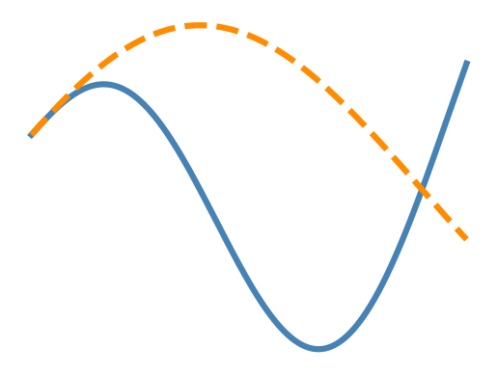



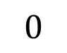
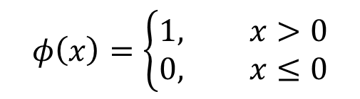


Representing Lipschitz-continuous functions
L$et g:[0,1]→$ $ℝ$ be a $L$-Lipschitz function and $ε>0$. Then a 2-layer neural network $f$ with threshold activation function $φ$ and $𝒪\left(\frac{L}{ε}\right)$ neurons exists that satisfies:
$${\left|g\left(x\right)−f\left(x\right)\right|}_{∞}<ε$$
Proof: see handwritten notes
Threshold function:
Supremum norm:
$$φ\left(x\right)=\left\{\begin{aligned}1, x>0 \\ &0, x≤0\end{aligned}\right.$$
$${\left|g\left(x\right)−f\left(x\right)\right|}_{∞}=\sup_{x}\left|g\left(x\right)−f\left(x\right)\right|$$
$$g$$
$$1$$
$$f$$
$$φ$$
$$0$$
$${\left|g\left(x\right)−f\left(x\right)\right|}_{∞}$$

Slide 9

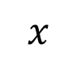
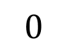


The same holds for ReLU activation functions!
L$et g:[0,1]→$ $ℝ$ be a $L$-Lipschitz function and $ε>0$. Then a 2-layer neural network $f$ with ReLU activation function $φ$ and $𝒪\left(\frac{L}{ε}\right)$ neurons exists that satisfies:
$${\left|g\left(x\right)−f\left(x\right)\right|}_{∞}<2ε$$
Proof: see handwritten notes
ReLU (rectified linear unit) function:
$$φ\left(x\right)=\max\left(0,x\right)$$
ReLU is one of the most used activation functions in deep learning!
$$x$$
$$0$$
$$φ$$

Slide 10
Final warm-up: going multivariate!
L$et g:{\left[0,1\right]}^{d}→$ $ℝ$ be a $L$-Lipschitz function and $ε>0$. Then a 3-layer neural network $f$ with threshold activation function $φ$ and $𝒪\left(\frac{L}{ε^{d}}\right)$ neurons exists that satisfies:
$${\left|g\left(x\right)−f\left(x\right)\right|}_{∞}<ε$$
Or in case of ReLU activation function:
$${\left|g\left(x\right)−f\left(x\right)\right|}_{∞}<2ε$$
Proof sketch: see handwritten notes
Note: We need one more layer compared to the univariate case. The first layer basically does the same as in the univariate case. The second layer takes the output of the first to identify in which hypercube we are! The third layer constructs the function from these hypercubes (as in 1D).

Slide 11
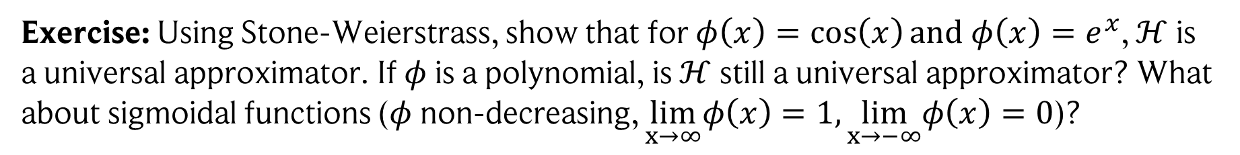
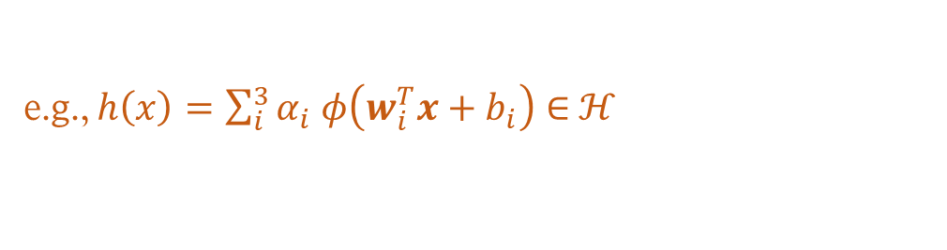
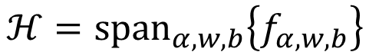
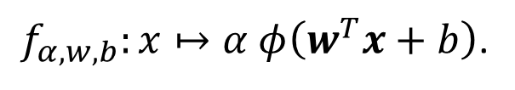
Are neural networks universal function approximators?
Our previous results are limited to Lipschitz continuous functions and special neural network architectures. Can we do better?
Yes! Using the Stone-Weierstrass theorem!
Let $ℋ$ be the hypothesis set consisting of shallow neural networks, i.e., neural networks with one hidden layer, given by:
$$ℋ={span}_{α,w,b}\left\{f_{α,w,b}\right\}$$
with single neurons
$f_{α,w,b}:x↦α φ\left(w^{T}x+b\right)$.
e.g., $h\left(x\right)=\sum_{i}^{3}{α_{i} φ\left(w_{i}^{T}x+b_{i}\right)}∈$ $ℋ$
Exercise: Using Stone-Weierstrass, show that for $φ\left(x\right)=\cos\left(x\right)and φ\left(x\right)=e^{x}$, $ℋ$ is a universal approximator. If $φ$ is a polynomial, is $ℋ$ still a universal approximator? What about sigmoidal functions ($φ$non-decreasing, $\lim_{x→∞}φ\left(x\right)=1,\lim_{x→−∞}φ\left(x\right)=0$)?
K. Hornik, M. Stinchcombe, H. White, Multilayer feedforward networks are universal approximators, 1989

Slide 12
If shallow ANNs are universal, what about depth?
Reminder: shallow = 1 hidden layer (what we dealt with so far)
But we can stack more hidden layers to go deep (usually done in practice).
Is there any benefit to depth?

Slide 13
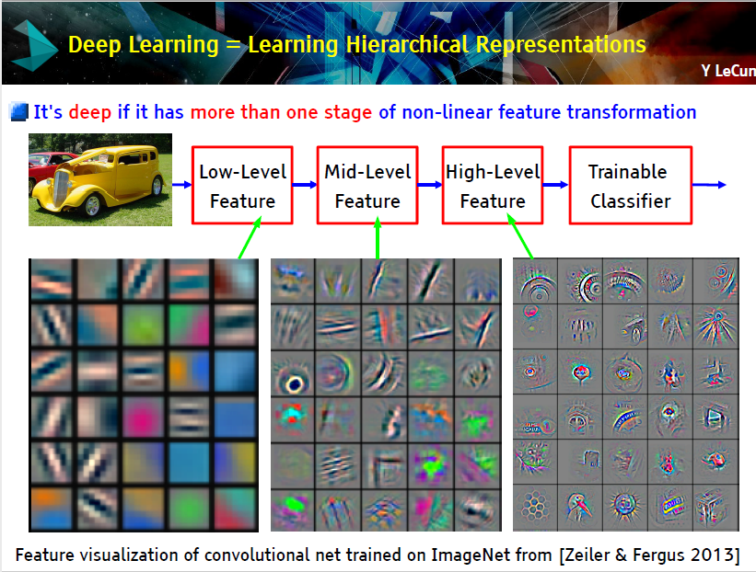
Intuitive picture: hierarchy of features
We utilized this in our constructions earlier! E.g., the 3-layer network: simple features from the first layer were used to construct more complex ones in the second one.
But that’s just an intuitive picture… can we show clear benefits of depth?
early layers
later layers
Image credit: Yann LeCun

Slide 14
A new tool: affine pieces
An affine / linear piece is a linear segment of a piecewise continuous function.
Examples:
ReLU (2 pieces)
A function with 5 pieces.
Generally, we are interested in the number of pieces a function has.
We will show later: the more pieces, the better we can fit functions!

Slide 15

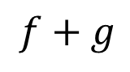

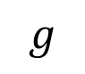
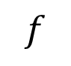
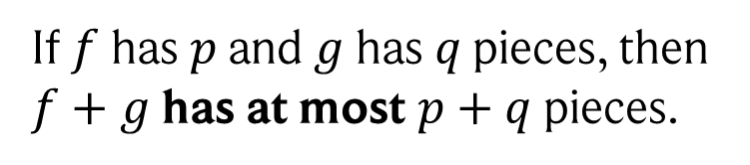
Addition and composition of piecewise functions
Adding and composing piecewise continuous functions results again in piecewise continuous functions with an increased (or unchanged) number of pieces.
Addition:
$$f$$
$$+$$
$$g$$
$$=$$
$$f+g$$
If $f$has $p$ and $g$ has $q$ pieces, then $f+g$ has at most $p+q$ pieces.

Slide 16
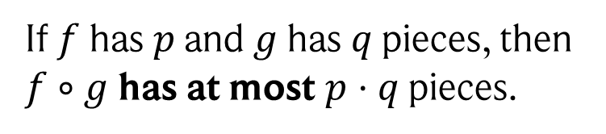
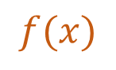
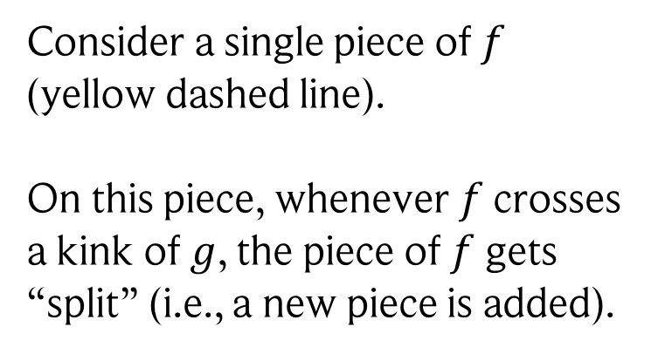
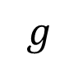

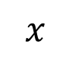
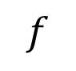
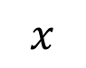
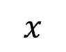
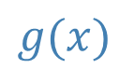
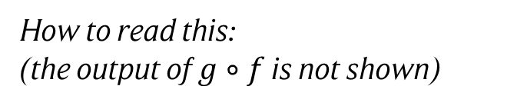
Addition and composition of piecewise functions
Adding and composing piecewise continuous functions results again in piecewise continuous functions with an increased (or unchanged) number of pieces.
Composition: $g∘f(x)$
Consider a single piece of $f$ (yellow dashed line).
On this piece, whenever $f$ crosses a kink of $g$, the piece of $f$ gets “split” (i.e., a new piece is added).
$$g(x)$$
How to read this: (the output of $g∘f$ is not shown)
$$x$$
$$f(x)$$
$$g$$
$$x$$
If $f$has $p$ and $g$ has $q$ pieces, then $f∘g$ has at most $p⋅q$ pieces.
$$f$$
$$x$$

Slide 17
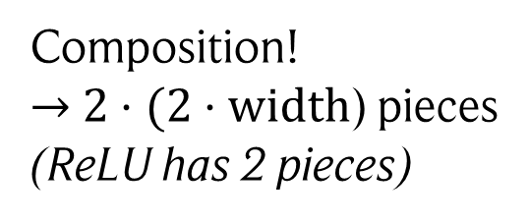
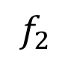
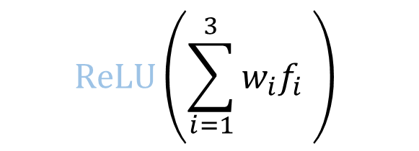





ReLU neural networks are piecewise continuous functions
ReLU neural networks are composed of ReLU functions, which are piecewise continuous.
Hence, ReLU neural networks are piecewise continuous functions!
How many pieces does such a network have?
Width:
Depth:
$$ReLU\left(\sum_{i=1}^{3}{w_{i}f_{i} }\right)$$
$$ReLU\left(\sum_{i=1}^{3}{w_{i}f_{i} }\right)$$
$$f_{1}$$
$$f_{2}$$
$$f_{3}$$
Addition!
$→$ $2⋅width$ pieces (2 pieces per neuron)
Composition!
$→$ $2⋅(2⋅width$) pieces (ReLU has 2 pieces)
width = # neurons in a layer
A ReLU neural network with $L$ layers and given width has at most ${\left(2⋅width\right)}^{L}$ affine pieces.

Slide 18

Example
Affine pieces of two different ReLU neural networks with two inputs and 1 output.
Image credit: Philipp Petersen, Jakob Zech, Mathematical Theory of Deep Learning (2025)

Slide 19



Why does this matter? Bounding the interpolation error!
Through the number of affine pieces, we get a lower bound on the interpolation error:
Let $f:\left[0,1\right]→ℝ$ be a continuous and three-times differentiable function. Then there exists a constant $C$ such that for all ReLU neural networks $Ψ: ℝ→ℝ$ with $p$ affine pieces, we have:
$${\left|f−Ψ\right|}_{∞}≥\frac{C}{p^{2}}$$
Note: this is also true for multivariate input along lines. The statement here is also slightly simplified. Proof: see handwritten notes.
Specifically, with our previous result, we get:
$${\left|f−Ψ\right|}_{∞}≥C⋅{\left(2⋅width\right)}^{−2L}$$
BUT: the multiplicative behavior was only a best-case scenario, does this hold in practice?!
This clearly indicates a strong benefit of depth, as only with $L$, the bound decays exponentially!
C. L. Frenzen, T. Sasao, and J. T. Butler. “On the number of segments needed in a piecewise linear approximation” (2010)

Slide 20




The hat function
Consider the following 2-layer ReLU neural network:
$$Δ(x)=2\left[ReLU\left(x\right)−2⋅ReLU\left(x−\frac{1}{2}\right)+ReLU(x−1)\right]$$
$$ReLU(x)$$
2
-4
$$ReLU\left(x−0.5\right)$$
2
$$ReLU\left(x−1\right)$$

Slide 21







The hat function
Consider the following 2-layer ReLU neural network:
$$Δ(x)=2\left[ReLU\left(x\right)−2⋅ReLU\left(x−\frac{1}{2}\right)+ReLU(x−1)\right]$$
$$ReLU(x)$$
2
$$1$$
-4
$$ReLU\left(x−0.5\right)$$
2
$$0$$
$$0$$
$$0.5$$
$$1$$
$$−1$$
$$ReLU\left(x−1\right)$$

Slide 22





The hat function
Consider the following 2-layer ReLU neural network:
$$Δ(x)=2\left[ReLU\left(x\right)−2⋅ReLU\left(x−\frac{1}{2}\right)+ReLU(x−1)\right]$$
$$ReLU(x)$$
2
$$1$$
-4
$$x$$
$$ReLU\left(x−0.5\right)$$
2
$$0$$
$$0$$
$$0.5$$
$$1$$
$$−1$$
$$ReLU\left(x−1\right)$$

Slide 23

The hat function
Consider the following 2-layer ReLU neural network:
$$Δ(x)=2\left[ReLU\left(x\right)−2⋅ReLU\left(x−\frac{1}{2}\right)+ReLU(x−1)\right]$$
$$ReLU(x)$$
2
$$1$$
-4
$$x$$
$$ReLU\left(x−0.5\right)$$
2
$$0$$
$$0$$
$$0.5$$
$$1$$
$$−1$$
$$ReLU\left(x−1\right)$$

Slide 24

The hat function
Consider the following 2-layer ReLU neural network:
$$Δ(x)=2\left[ReLU\left(x\right)−2⋅ReLU\left(x−\frac{1}{2}\right)+ReLU(x−1)\right]$$
$$ReLU(x)$$
2
$$1$$
-4
$$x$$
$$ReLU\left(x−0.5\right)$$
2
$$0$$
$$0$$
$$0.5$$
$$1$$
$$−1$$
$$ReLU\left(x−1\right)$$

Slide 25

The hat function
Consider the following 2-layer ReLU neural network:
$$Δ(x)=2\left[ReLU\left(x\right)−2⋅ReLU\left(x−\frac{1}{2}\right)+ReLU(x−1)\right]$$
$$ReLU(x)$$
2
$$1$$
-4
$$x$$
$$ReLU\left(x−0.5\right)$$
2
$$0$$
$$0$$
$$0.5$$
$$1$$
$$−1$$
$$ReLU\left(x−1\right)$$

Slide 26











What happens if we compose the hat function with itself?
F$or x∈[0,1]$, $Δ\left(x\right)$ covers the range [0,1] twice in its output.
$$Δ∘Δ\left(x\right)=2 hats$$
$Δ∘Δ(x)$ covers the range [0,1] four times in its output.
$$Δ∘Δ∘Δ\left(x\right)=4 hats$$
$$n=1$$
$$n=2$$
$$n=3$$
$$n=6$$
$Δ^{n}(x)$ has $2^{n}$ pieces (each hat has 2)
$Δ^{n}(x)$ is also known as the “sawtooth function”
M. Telgarsky, Benefits of depth in neural networks (2016)

Slide 27



The power of deep neural networks
To calculate $Δ^{n}\left(x\right),$ we just have to stack our small ReLU neural network $n$ times.
$$x$$
$$Δ^{3}(x)$$
Thus, there is a deep ReLU ANN with $𝓞(n)$ neurons and $n$ layers that perfectly fits $Δ^{n}\left(x\right).$
In contrast, a shallow network has$2⋅width$ pieces $→2^{n−1}$ neurons needed!
This is a clear separation in the capabilities of shallow and deep neural networks!

Slide 28












The square function
But there is more! We can use the hat function to build $x^{2}$ with exponential error rate (in $n$)!
$$s_{n}\left(x\right)=x −\sum_{j=1}^{n}{\frac{Δ^{j}\left(x\right)}{4^{j}}}$$
for $x∈[0,1]$
$$s_{1}(x)$$
$$s_{2}(x)$$
$${\left|x^{2}−s_{n}\left(x\right)\right|}_{∞}$$
$$x$$
$$x$$
$$x$$
$$n$$
D. Yarotsky, Error bounds for approximations with deep ReLU networks (2017)

Slide 29














A neural network approximating the square function
This can again be realized efficiently by a deep ReLU neural network:
$$s_{1}\left(x\right)=s_{0}(x)−\frac{Δ\left(x\right)}{4}$$
$$s_{2}(x)$$
$$s_{n}\left(x\right)=x −\sum_{j=1}^{n}{\frac{Δ^{j}\left(x\right)}{4^{j}}}$$
$$s_{0}\left(x\right)=ReLU(x)$$
$$s_{n−1}(x)$$
$$=s_{n−1}\left(x\right)−\frac{Δ^{n}\left(x\right)}{4^{n}}$$
…
$$x$$
$$s_{n}(x)$$
$$=ReLU\left(s_{n−1}\left(x\right)\right)−\frac{{Δ∘Δ}^{n−1}\left(x\right)}{4^{n}}$$
$$since this is>0$$
$$Δ(x)$$
$$Δ^{2}(x)$$
$$Δ^{3}(x)$$
Thus, there is a deep ReLU ANN with $𝓞(n)$ neurons and $n$layers that approximates $x^{2}$ with error $ε$ that decays exponentially in $n$.
For shallow neural networks, the decay is only polynomial : ${\left|x^{2}−Ψ\right|}_{∞}≥C⋅{\left(2⋅width\right)}^{−2}$

Slide 30




But wait… there is more!
$$x⋅y={\left(\frac{x+y}{2}\right)}^{2}−{\left(\frac{x−y}{2}\right)}^{2}$$
We can use a little trick: the polarization identity
This is only addition and squaring, two operations that (as we showed) can be represented using a deep ReLU neural network!
Thus, we can model any multiplication,
such as $x^{3}=x^{2}⋅x$!
$x^{3}$ modelled using our ReLU square circuits!

Slide 31

And… more!
Via multiplication, we can build polynomials!
Thus, we can approximate polynomials efficiently with deep ReLU neural networks!
Thus, we can approximate polynomials efficiently with deep ReLU neural networks!
In fact, there exists a deep ReLU neural network with $𝓞\left(k⋅log\left(k/ε\right)\right)$ parameters and $𝓞\left(log\left(k/ε\right)\right)$layers that approximates a degree $k≥2$ polynomial with error $ε$.
In fact, this extends to Taylor series expansions, and hence to any analytic function!
To conclude, we now found a rather big and highly relevant set of functions where a shallow neural network requires far more parameters than a deep neural network!
Note: this is another way to show universal approximation, as we showed that we can approximate polynomials, which are universal approximators, efficiently with deep ReLU neural networks.

Slide 32







The reality gap…
One might ask: do we find these neural networks with exponential many pieces in practice?
This is an active area of research, but preliminary results suggest: rarely…
In fact, even our construction for $Δ^{n}(x)$ collapses to only linearly many pieces if we noise the weights and biases a bit…!
For $n=30:$
w$ith noise$
$$ReLU ANN$$
$$x$$
$$x$$
B. Hanin & D. Rolnick, Complexity of Linear Regions in Deep Networks (2019)

Slide 33







How are neural networks trained in practice?
Using empirical risk minimization, i.e., we minimize a loss function.
In case of neural networks, this is usually done via gradient descent.
$$W_{2}$$
$$W_{1}$$
$$W_{3}$$
$$x$$
$$Ψ(x)$$
$$L=\sum_{i}{{\left\|Ψ\left(x_{i}\right)−y_{i}\right\|}^{2} }$$
$$W_{j}←W_{j}−η∇_{W_{j}}L$$
Intuition: neural network = function composed of many small simple functions (neurons).
Changing the parameters of all these functions a bit leads to a small change in the output.
Thus, we can do many small steps to slowly walk the output to its target!

Slide 34












Automatic Differentiation
How can we calculate the gradients efficiently?
Since neural networks are compositions of simple operations, let’s first have a look at the derivative of a function composition!
${gradf}_{1}=$ $\frac{∂g}{∂f_{1}}gradg$
$$f_{1}$$
$$f_{2}$$
$${gradf}_{2}$$
$$x$$
$$g\left(f_{1}\left(x\right), f_{2}\left(x\right), f_{3}\left(x\right)\right)$$
$grad x=$ $\sum_{i}{\frac{∂f_{i}}{∂x}grad}f_{i}$
$$g$$
$$grad g=1$$
$${gradf}_{3}$$
$$f_{3}$$
$$\frac{∂g}{∂x}=\sum_{i=1}^{3}{\frac{∂f_{i}}{∂x}\frac{∂g}{∂f_{i}}=\frac{∂f_{1}}{∂x}\frac{∂g}{∂f_{1}}⋅1+\frac{∂f_{2}}{∂x}\frac{∂g}{∂f_{2}}⋅1+\frac{∂f_{3}}{∂x}\frac{∂g}{∂f_{3}}}⋅1$$
Using the chain rule:

Slide 35






Automatic Differentiation
Let’s have a closer look!
${gradf}_{1}=$ $\frac{∂g}{∂f_{1}}gradg$
Along edges, we propagate products (like message passing)!
$$\frac{∂g}{∂f_{1}}$$
$$grad g$$

Slide 36


Automatic Differentiation
Let’s have a closer look!
${gradf}_{1}=$ $\frac{∂g}{∂f_{1}}gradg$
Along edges, we propagate products (like message passing)!
$$\frac{∂f_{1}}{∂x}$$
$$\frac{∂g}{∂f_{1}}$$
$${\frac{∂f_{1}}{∂x} gradf}_{1}$$
$$grad g$$

Slide 37



Automatic Differentiation
Let’s have a closer look!
Along edges, we propagate products (like message passing)!
$${\frac{∂f_{3}}{∂x} gradf}_{3}$$
$$grad g$$
$$\frac{∂f_{3}}{∂x}$$
$${ gradf}_{3}=\frac{∂g}{∂f_{3}}gradg$$

Slide 38












Automatic Differentiation
Let’s have a closer look!
$${gradf}_{1}$$
Along edges, we propagate products (like message passing)!
$$\frac{∂f_{1}}{∂x}$$
$$\frac{∂g}{∂f_{1}}$$
$$\frac{∂f_{2}}{∂x}$$
At nodes, we sum up all incoming messages.
$grad x=$ $\sum_{i}{\frac{∂f_{i}}{∂x}grad}f_{i}$
$${gradf}_{2}$$
$$grad g$$
$$\frac{∂f_{3}}{∂x}$$
$${gradf}_{3}$$

Slide 39
Automatic Differentiation
Let’s have a closer look!
$${gradf}_{1}$$
Along edges, we propagate products (like message passing)!
$$\frac{∂f_{1}}{∂x}$$
$$\frac{∂g}{∂f_{1}}$$
$$\frac{∂f_{2}}{∂x}$$
At nodes, we sum up all incoming messages.
$grad x=$ $\sum_{i}{\frac{∂f_{i}}{∂x}grad}f_{i}$
$${gradf}_{2}$$
$$grad g$$
$$\frac{∂f_{3}}{∂x}$$
Thus: We can represent the derivative as a graph which is the “inverse” of the original computational (“forward”) graph! You usually find the following structure:
$${gradf}_{3}$$
Forward function: our original function, from which we constructed the computational graph.
Backward function: calculates the gradient for each node in the graph. Its structure is inverse to the forward graph and gradients are propagated as inputs!
In tools like PyTorch, every node in the graph has a forward and backward function from which the computational graph is constructed node by node!

Slide 40







Example
Let’s try this for the following function: $L\left(x\right)=\frac{1}{2}{\left\|{\left(w⋅x\right)}^{2}−1\right\|}^{2}$
Build the forward graph. We denote by $x_{j}^{i}$ the output of the $i$’th node in layer $j$.
$$x_{0}^{0}$$
$$x_{0}^{0}⋅x_{0}^{1}$$
$$x_{1}^{0}⋅x_{1}^{0}$$
$$x_{2}^{0}−1$$
$$\frac{1}{2}{\left\|x_{3}^{0}\right\|}^{2}$$
$$x_{0}^{1}$$
$L(x)$is recovered when setting $x_{0}^{0}=x$ and $x_{0}^{1}=w$.

Slide 41






Example
Let’s try this for the following function: $L\left(x\right)=\frac{1}{2}{\left\|{\left(w⋅x\right)}^{2}−1\right\|}^{2}$
Build the forward graph. We denote by $x_{j}^{i}$ the output of the $i$’th node in layer $j$.
$$x_{0}^{0}$$
$$x_{0}^{0}⋅x_{0}^{1}$$
$$x_{1}^{0}⋅x_{1}^{0}$$
$$x_{2}^{0}−1$$
$$\frac{1}{2}{\left\|x_{3}^{0}\right\|}^{2}$$
$$x_{0}^{1}$$
$L(x)$is recovered when setting $x_{0}^{0}=x$ and $x_{0}^{1}=w$.
Build the backward graph. We denote layer inputs by $g_{j}^{i}$.
$$x_{0}^{1}⋅g_{1}^{0}$$
$$g_{4}^{0}=1$$
$$2 x_{1}^{0}⋅g_{2}^{0}$$
$$1⋅g_{3}^{0}$$
$$\left\|x_{3}^{0}\right\|⋅g_{4}^{0}$$
$$x_{0}^{0}⋅g_{1}^{0}$$

Slide 42






Example
Let’s try this for the following function: $L\left(x\right)=\frac{1}{2}{\left\|{\left(w⋅x\right)}^{2}−1\right\|}^{2}$
Build the forward graph. We denote by $x_{j}^{i}$ the output of the $i$’th node in layer $j$.
$$x_{0}^{0}$$
$$2$$
$$2$$
$$4$$
$$3$$
$$4.5$$
$$x_{0}^{0}⋅x_{0}^{1}$$
$$x_{1}^{0}⋅x_{1}^{0}$$
$$x_{2}^{0}−1$$
$$\frac{1}{2}{\left\|x_{3}^{0}\right\|}^{2}$$
$$x_{0}^{1}$$
$$1$$
Build the backward graph. We denote layer inputs by $g_{j}^{i}$.
$$x_{0}^{1}⋅g_{1}^{0}$$
$$g_{4}^{0}=1$$
$$2 x_{1}^{0}⋅g_{2}^{0}$$
$$1⋅g_{3}^{0}$$
$$\left\|x_{3}^{0}\right\|⋅g_{4}^{0}$$
$$x_{0}^{0}⋅g_{1}^{0}$$

Slide 43







Example
Let’s try this for the following function: $L\left(x\right)=\frac{1}{2}{\left\|{\left(w⋅x\right)}^{2}−1\right\|}^{2}$
Build the forward graph. We denote by $x_{j}^{i}$ the output of the $i$’th node in layer $j$.
$$x_{0}^{0}$$
$$2$$
$$2$$
$$4$$
$$3$$
$$4.5$$
When our function is a deep neural network, then this method is called error backpropagation.
Why? Because the gradient of the last node is the error! In the example here, that’s $\left\|x_{3}^{0}\right\|$
$$x_{0}^{0}⋅x_{0}^{1}$$
$$x_{1}^{0}⋅x_{1}^{0}$$
$$x_{2}^{0}−1$$
$$\frac{1}{2}{\left\|x_{3}^{0}\right\|}^{2}$$
$$x_{0}^{1}$$
$$1$$
Build the backward graph. We denote layer inputs by $g_{j}^{i}$.
$$12$$
See also: coding examples.
$$x_{0}^{1}⋅g_{1}^{0}$$
$$12$$
$$3$$
$$3$$
$$g_{4}^{0}=1$$
$$1$$
$$2 x_{1}^{0}⋅g_{2}^{0}$$
$$1⋅g_{3}^{0}$$
$$\left\|x_{3}^{0}\right\|⋅g_{4}^{0}$$
$$24$$
$$x_{0}^{0}⋅g_{1}^{0}$$
Note: You can also construct a forward graph to calculate the gradients. This is called forward-mode automatic differentiation. But commonly, backward-mode is used in practice.

